Slide 1
International Tea Day
Work done by:
9º A

Slide 2
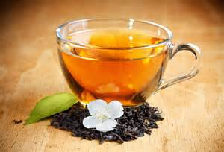
Flower tea jasmine

Slide 3

Country of origin: China.
Benefits of jasmine tea:
- reduces the appearance of wrinkles;
- reduces cholesterol and prevents the onset of cancer;
- lessens stress and fatigue.

Slide 5

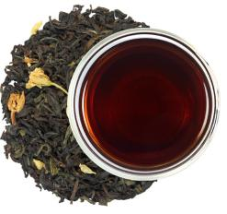
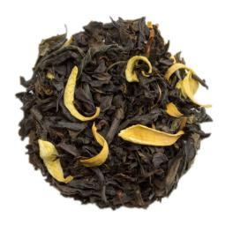
Oolong tea
Country of origin: China.
Benefits:
-Weight Management;
-Removal of harmful free radicals;
-Controls diabetes.

Slide 6

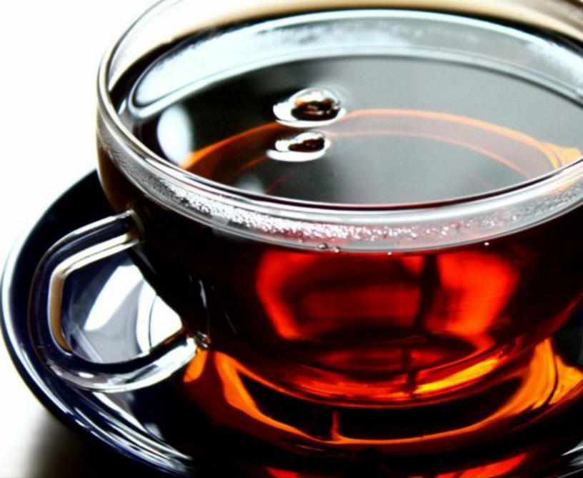

Black Tea
The original country of black tea is India.
Black tea includes beneficial impacts for high cholesterol, diarrhea, tooth decay, low-concentration levels, digestive problems, poor blood circulation, high blood pressure, and asthma.

