Slide 1

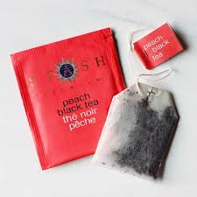
International Tea Day
Celebrated on the
15th December

Slide 2
International Tea Day
All the work done by:
8º C

Slide 3


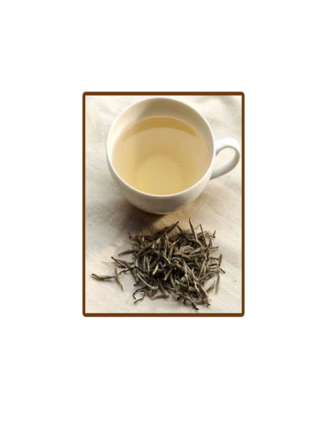
- Country of origin: China
- Health Benefits:
•reduces risk of cancer;
•protects skin from ultraviolet light;
•helps in losing weight.

Slide 4
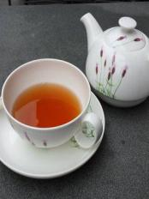
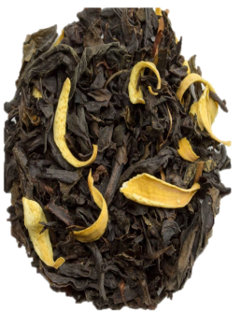
Oolong flower – Orange tea
It’s a traditional Chinese tea.
Health benefits:
- Weight management
- Controls diabetes
- Anti-cancer proprieties

Slide 5

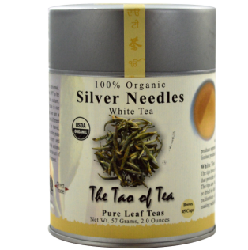
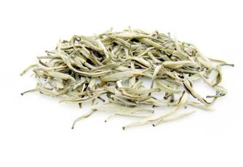
White Tea – Silver Needle
The white tea (Silver Needle) is from China.
Health benefits of white tea include:
- reduced risk of cancer,
- cardiovascular disorder,
- improvement in oral health.

Slide 6



Black Tea
The black tea has its origins in China many thousands of years ago. Here are some of its benefits:
Cancer Prevention: some research over the years suggests that this tea’s antioxidants may help prevent some types of cancer.
Oral Health: black tea reduces plaque formation as well as restricts bacteria growth that promotes the formation of cavities and tooth decays.

Slide 7

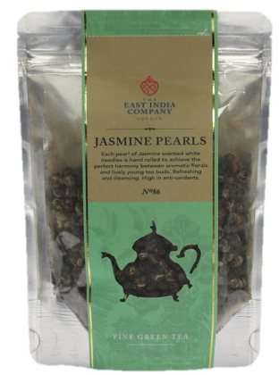
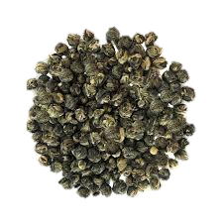

Green Tea – Jasmine Pearl
Country of origin: China
Some benefits:
Reduced risk of hearth attacks.
A stronger immune system.
Prevents cancer and diabetes.

Slide 8
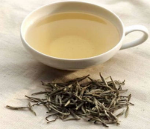


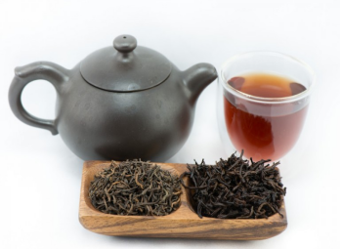
The 4 types of tea are:
White tea
Green tea
Black tea
Pu-erh tea

Slide 9
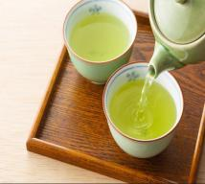
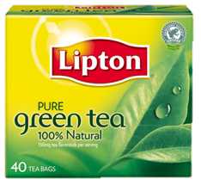

GREEN TEA
The green tea has a lot of benefits in our health. It helps to:
- Reduce ageing risks
Reduce bad cholesterol
Reduce blood pressure

